Slide 1
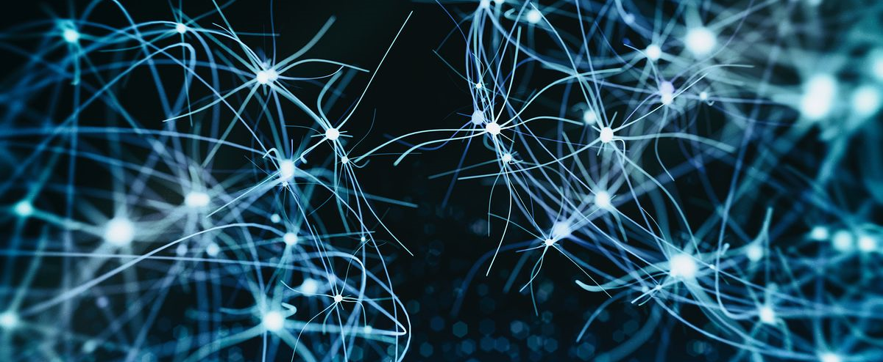

BMB3015 ARTIFICIAL INTELLIGENCE
TEMPORAL PROBABILISTIC REASONING &
HIDDEN MARKOV MODELS

Slide 2
HMM Example
Imagine that a climatologist in the year 2799 studying the history of global warming.
No records of the weather in Bursa for the summer of 2023
Feyza’s diary, which lists how many ice creams Feyza ate every day that summer
Goal is using these observations to estimate the temperature every day
Assume there are only two kinds of days:
cold (C) and hot (H)
So the task is:
Given a sequence of observations O,
integers corresponding to the number of ice creams eaten on a given day
Figure out the correct ‘hidden’ sequence Q
The weather states (H or C)

Slide 3
Time and Uncertainty
The world changes, we need to track and predict it
Diabetes management versus vehicle diagnosis
Basic idea: copy state and evidence variables for each time step
Q_{t} = set of unobservable state variables at time t
e.g., BloodSugar_{t}, StomachContents_{t}, etc.
O_{t} = set of observable evidence variables at time t
e.g., MeasuredBloodSugar_{t}, PulseRate_{t}, FoodEaten_{t}
This assumes discrete time, step size depends on problem
Notation: Q_{a:b} = Q_{a};Q_{a+1}; …;Q_{b-1};Q_{b}

Slide 4
Temporal Proabilistic Reasoning
Temporal models use
state variables
observation (sensor) variables
replicated over time,
Markov assumptions and stationarity assumption, so we need
transition model P(Q_{t}|Q_{t-1})
observation (sensor) model P(O_{t}|Q_{t})

Slide 5
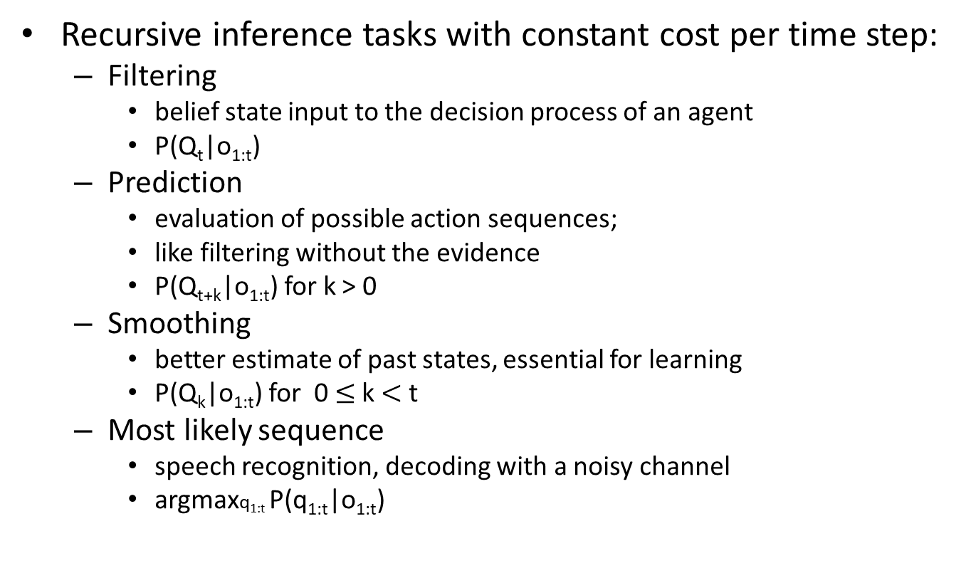
Inference Tasks
Recursive inference tasks with constant cost per time step:
Filtering
belief state input to the decision process of an agent
P(Q_{t}|o_{1:t})
Prediction
evaluation of possible action sequences;
like filtering without the evidence
P(Q_{t+k}|o_{1:t}) for k > 0
Smoothing
better estimate of past states, essential for learning
P(Q_{k}|o_{1:t}) for 0 $≤$ k $<$ t
Most likely sequence
speech recognition, decoding with a noisy channel
argmaxq_{1:t} P(q_{1:t}|o_{1:t})

Slide 6
Temporal Probabilistic Reasoning Algorithms
Temporal probabilistic reasoning algorithms that are based on Bayesian inference method
Hidden Markov Models (HMM)
have a single discrete state variable
can be used for speech recognition
Kalman Filters (KF)
n continuous state variables,
assumes linear transition model based on Gaussian
O(n³) update
Dynamic Bayesian Networks (DBN)
subsume HMMs, Kalman filters
single state or multiple state variables are possible
exact update intractable
Particle Filters
a good approximate filtering algorithm for DBNs
Notes:
intractable: kontrol edilmesi zor

Slide 7
Hidden Markov Models (HMM)
A sequence model
assigns a label or class to each unit in a sequence,
maps a sequence of observations to a sequence of labels.
An HMM is a probabilistic sequence model:
given a sequence of units (words, letters, morphemes, sentences,…),
computes a probability distribution over possible sequences of labels and choose the best label sequence.
Sequence labeling tasks come up throughout speech and language processing.
part-of-speech tagging: words to subject, object, verb, adverb, etc.
named entity tagging: words to person, organization, time, place, etc.
[Jim]_{Person} bought 300 shares of [Acme Corp.]_{Organization} in [2006]_{Time}.
speech recognition: audio signals to text
text correction: inaccurate text to correct text

Slide 8
Markov Chains
A Markov chain
is a special case of a weighted automaton
weights are probabilities
the input sequence uniquely determines which states the automaton will go through
can’t represent inherently ambiguous problems, so only useful for assigning probabilities to unambiguous sequences

Slide 9
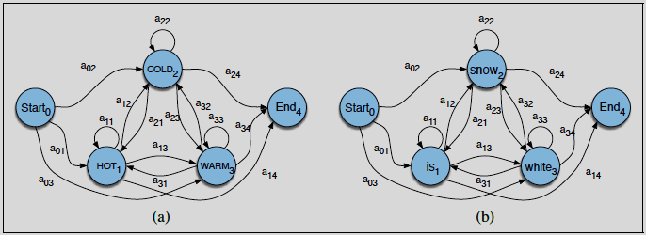
Markov Chains
A Markov chain is specified by the structure, the transition between states, and the start and end states.
A Markov chain for assigning a probability to a sequence of weather events
vocabulary consists of HOT, COLD, WARM
A Markov chain of words for assigning a probability to a sequence of words vocabulary consists of is, snow, white

Slide 10
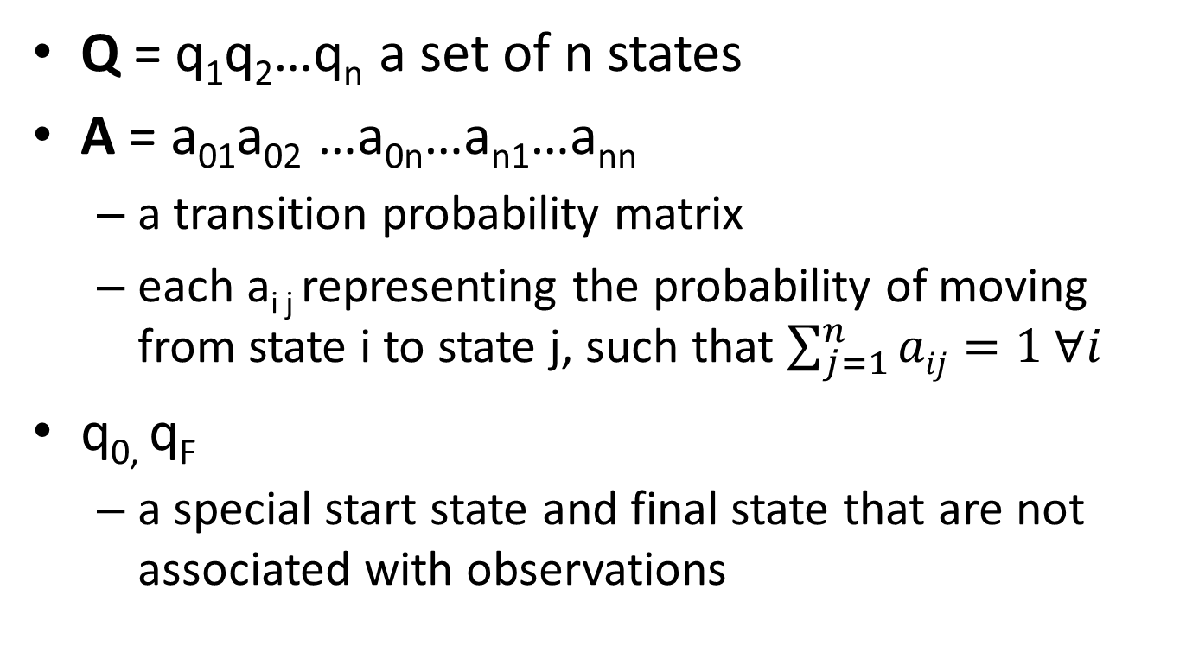
Formal Definition of a Markov Chain
Q = q₁q₂…q_{n} a set of n states
A = a₀₁a₀₂ …a_{0n}…a_{n1}…a_{nn}
a transition probability matrix
each a_{i j} representing the probability of moving from state i to state j, such that $\sum_{j=1}^{n}{aij}=1 ∀i$
q_{0,} q_{F}
a special start state and final state that are not associated with observations

Slide 11
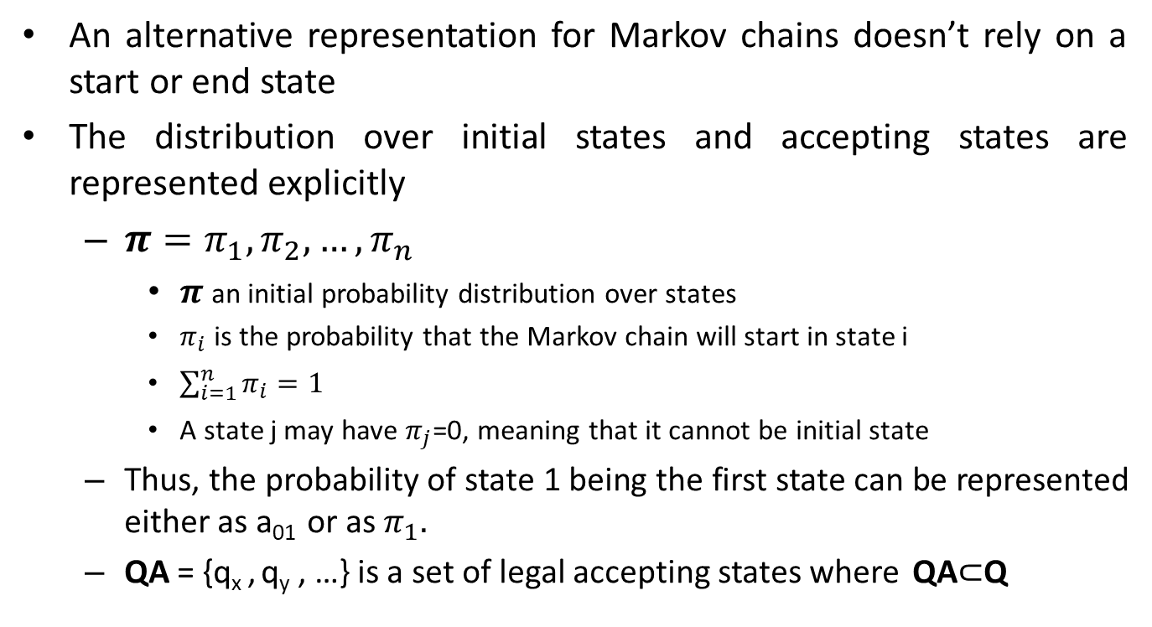
Alternative Representation of Markov Chains
An alternative representation for Markov chains doesn’t rely on a start or end state
The distribution over initial states and accepting states are represented explicitly
$π=π_{1},π_{2},…,π_{n}$
$π$an initial probability distribution over states
$π_{i}$ is the probability that the Markov chain will start in state i
$\sum_{i=1}^{n}{π_{i}}=1$
A state j may have $π_{j}$=0, meaning that it cannot be initial state
Thus, the probability of state 1 being the first state can be represented either as a₀₁ or as $π_{1}.$
QA = {q_{x} , q_{y} , …} is a set of legal accepting states where QA$⊂$Q

Slide 12
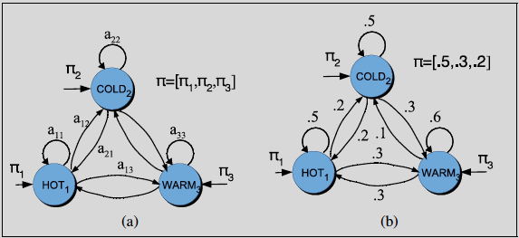
Alternative Representation of Markov Chains

Slide 13
Markov Processes (Markov Chains)
Markov Assumption:
Q_{t} depends on bounded subset of Q_{0:t-1}
First-Order Markov Chain:
the probability of a particular state depends only on the previous state:
P(Q_{t}|Q_{0:t-1}) = P(Q_{t}|Q_{t-1})

Slide 14
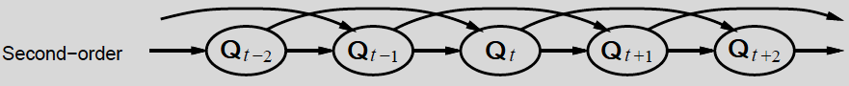
Second-Order Markov Chain
Second-Order Markov Chain:
P(Q_{t}|Q_{0:t-1}) = P(Q_{t}|Q_{t-1},Q_{t-2})
Sensor Markov assumption:
P(O_{t}|Q_{0:t} ,O_{t-1}) = P(O_{t}|Q_{t})
Stationarity assumption:
a transition model P(Q_{t}|Q_{t-1})
a sensor (observation) model P(O_{t}|Q_{t})

Slide 15
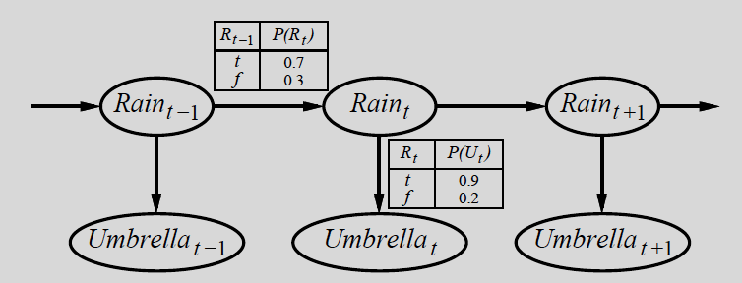
First-Order Markov Assumption Problems
First-order Markov assumption not exactly true in real world!
Possible fixes:
Increase order of Markov process
e.g., second- order Markov, third-order Markov
Augment state
e.g., add Temp_{t}, Pressure_{t}
Example: robot motion
Augment position and velocity with Battery_{t}

Slide 16
Hidden Markov Model
A Markov chain is useful when
we need to compute a probability for a sequence of events that are observable in the world.
In many cases the events we are interested in may not be directly observable in the world.
Example 1:
Part-of-speech tags are not observable in the world
The words are observable
Therefore, the part-of-speech tags are called hidden
We have to infer the correct tags from the word sequence
Example 2:
In speech recognition acoustic events in the world are observable
The underlying causal source of the acoustics are “hidden” words
We try to infer the presence of “hidden” words

Slide 17
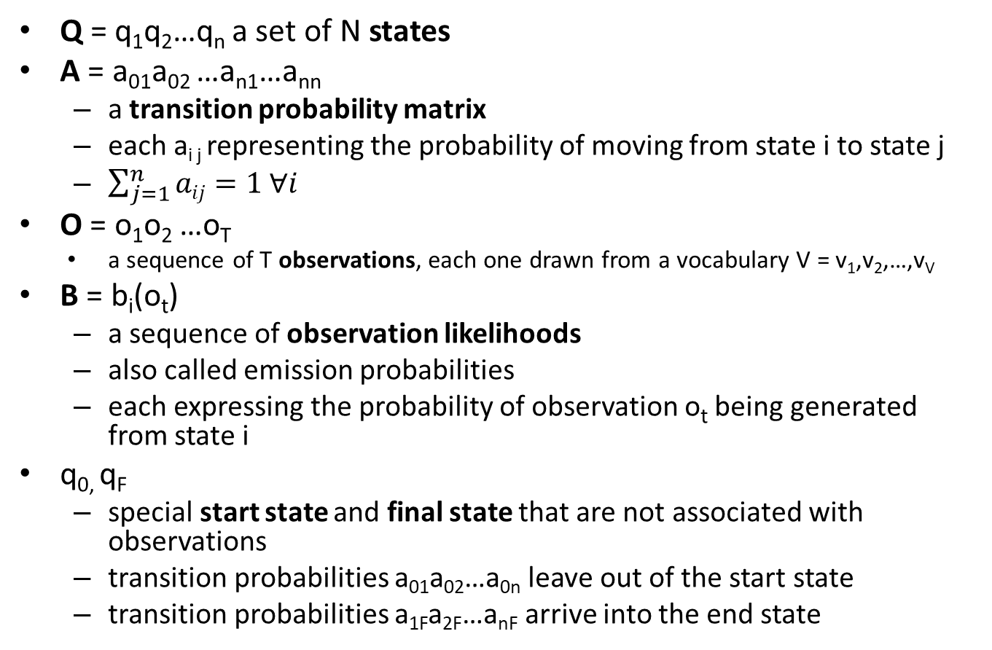
Formal Definition of HMM
Q = q₁q₂…q_{n} a set of N states
A = a₀₁a₀₂ …a_{n1}…a_{nn}
a transition probability matrix
each a_{i j} representing the probability of moving from state i to state j
$\sum_{j=1}^{n}{aij}=1 ∀i$
O = o₁o₂ …o_{T}
a sequence of T observations, each one drawn from a vocabulary V = v₁,v₂,…,v_{V}
B = b_{i}(o_{t})
a sequence of observation likelihoods
also called emission probabilities
each expressing the probability of observation o_{t} being generated from state i
q_{0,} q_{F}
special start state and final state that are not associated with observations
transition probabilities a₀₁a₀₂…a_{0n} leave out of the start state
transition probabilities a_{1F}a_{2F}…a_{nF} arrive into the end state

Slide 18
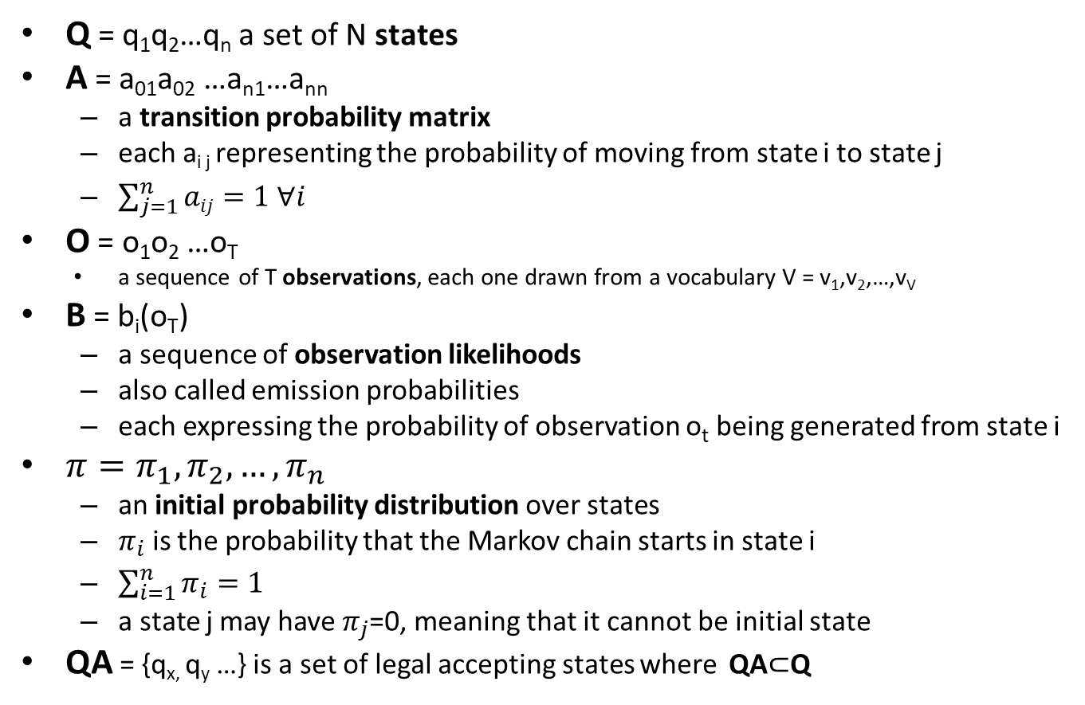
Alternative Formal Definition of HMM
Q = q₁q₂…q_{n} a set of N states
A = a₀₁a₀₂ …a_{n1}…a_{nn}
a transition probability matrix
each a_{i j} representing the probability of moving from state i to state j
$\sum_{j=1}^{n}{aij}=1 ∀i$
O = o₁o₂ …o_{T}
a sequence of T observations, each one drawn from a vocabulary V = v₁,v₂,…,v_{V}
B = b_{i}(o_{T})
a sequence of observation likelihoods
also called emission probabilities
each expressing the probability of observation o_{t} being generated from state i
$π=π_{1},π_{2},…,π_{n}$
an initial probability distribution over states
$π_{i}$ is the probability that the Markov chain starts in state i
$\sum_{i=1}^{n}{π_{i}}=1$
a state j may have $π_{j}$=0, meaning that it cannot be initial state
QA = {q_{x,} q_{y} …} is a set of legal accepting states where QA$⊂$Q

Slide 19
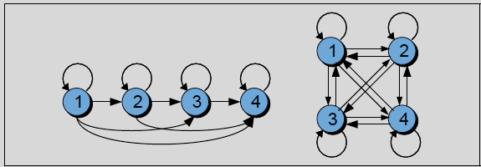
Some HMM Types
Ergodic HMM (fully connected)
If there is a non-zero probability of transitioning between any two states
Bakis HMM
Many of the transitions between states have zero probability.
For example, in left-to-right HMMs,
the state transitions proceed from left to right,
right to left transitions have zero probability
generally used to model temporal processes like speech
Bakis HMM
Ergodic HMM

Slide 20
First-Order HMM
Two simplifying assumptions:
The probability of a particular state depends only on the previous state:
Markov Assumption: P(q_{i}|q₁…q_{i-1}) = P(q_{i}|q_{i-1})
The probability of an output observation o_{i} depends only on the state q_{i} that produced the observation and not on any other states or any other observations:
Sensor Assumption (Output Independence):
P(o_{i}|q₁,…,q_{i},…,q_{t}, o₁,…,o_{i},…,o_{t}) = P(o_{i}|q_{i})

Slide 21
HMM Example Reminder
Imagine that a climatologist in the year 2799 studying the history of global warming.
No records of the weather in Bursa for the summer of 2023
Feyza’s diary, which lists how many ice creams Feyza ate every day that summer
Goal is using these observations to estimate the temperature every day
Assume there are only two kinds of days:
cold (C) and hot (H)
So the task is:
Given a sequence of observations O,
integers corresponding to the number of ice creams eaten on a given day
Figure out the correct ‘hidden’ sequence Q
The weather states (H or C)

Slide 22
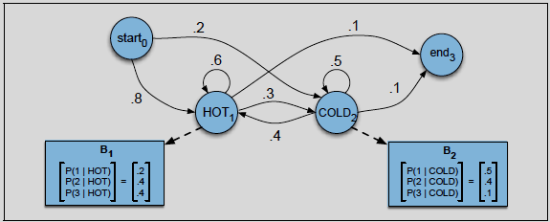
A Sample HMM for the Ice Cream Task
The two hidden states (H and C) correspond to hot and cold weather
The observations (drawn from the alphabet O = {1,2,3}) correspond to the number of ice creams eaten by Feyza on a given day

Slide 23
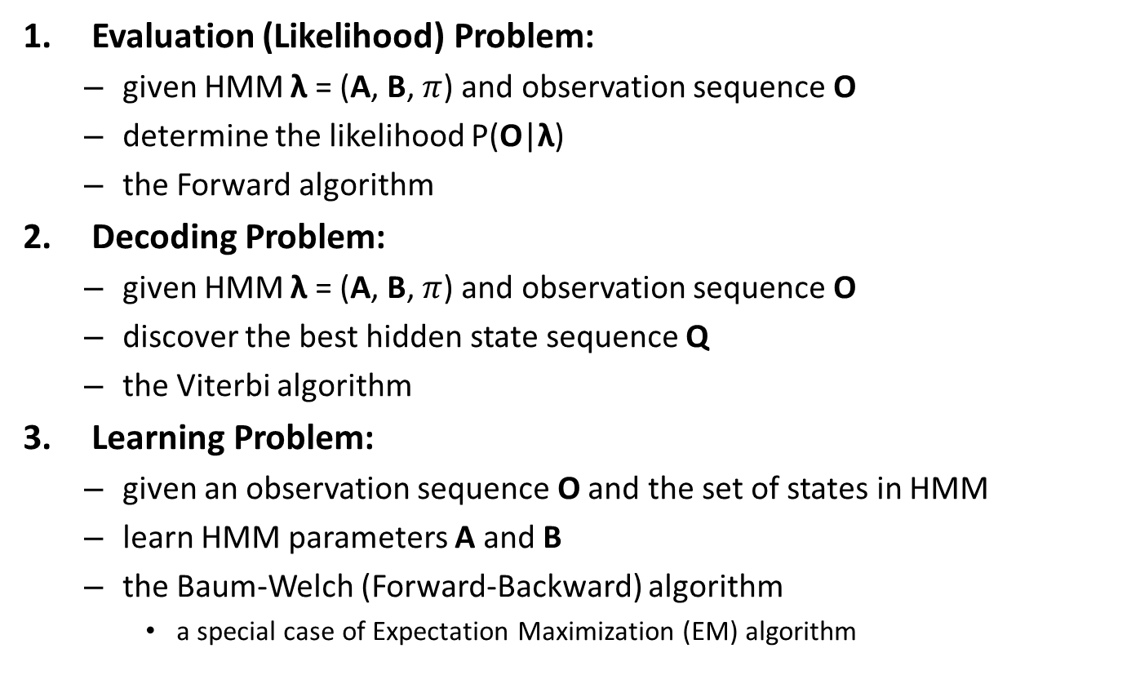
Three Fundamental HMM Problems
Evaluation (Likelihood) Problem:
given HMM λ = (A, B, $π$) and observation sequence O
determine the likelihood P(O|λ)
the Forward algorithm
Decoding Problem:
given HMM λ = (A, B, $π$) and observation sequence O
discover the best hidden state sequence Q
the Viterbi algorithm
Learning Problem:
given an observation sequence O and the set of states in HMM
learn HMM parameters A and B
the Baum-Welch (Forward-Backward) algorithm
a special case of Expectation Maximization (EM) algorithm

Slide 24
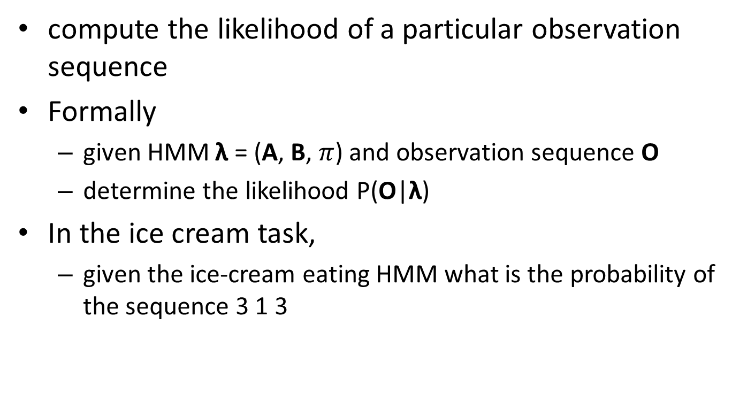
Likelihood Computation
compute the likelihood of a particular observation sequence
Formally
given HMM λ = (A, B, $π$) and observation sequence O
determine the likelihood P(O|λ)
In the ice cream task,
given the ice-cream eating HMM what is the probability of the sequence 3 1 3

Slide 25
Likelihood Computation
For a Markov chain
the surface observations are the same as the hidden events
we could compute the probability of 3 1 3 just by following the states labeled 3 1 3 and multiplying the probabilities along the arcs
For HMM
have to determine the probability of an ice-cream observation sequence like 3 1 3
but we don’t know what the hidden state sequence is!

Slide 26
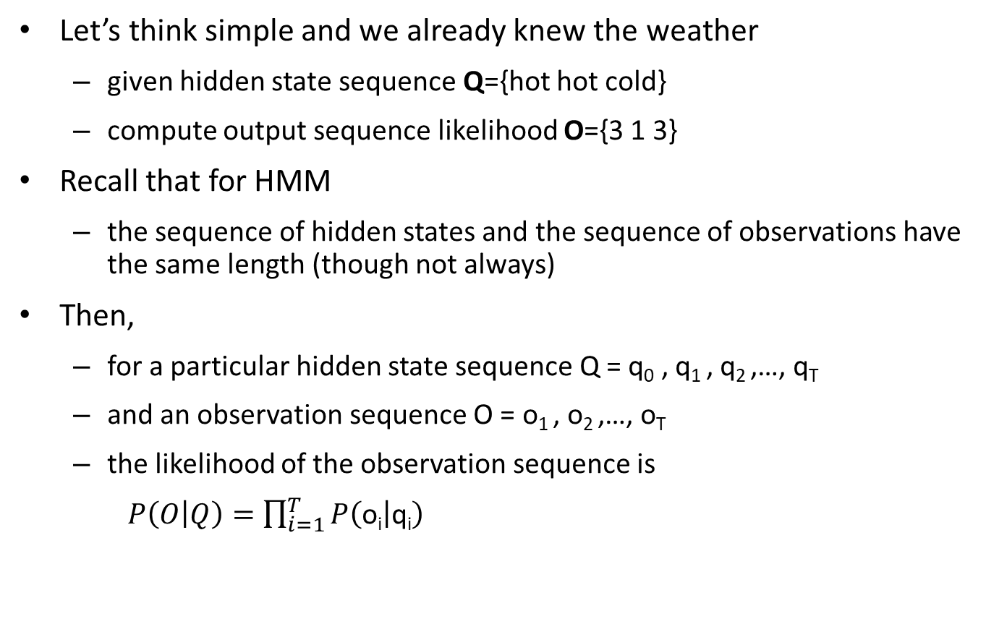
Likelihood Computation
Let’s think simple and we already knew the weather
given hidden state sequence Q={hot hot cold}
compute output sequence likelihood O={3 1 3}
Recall that for HMM
the sequence of hidden states and the sequence of observations have the same length (though not always)
Then,
for a particular hidden state sequence Q = q₀ , q₁ , q₂ ,…, q_{T}
and an observation sequence O = o₁ , o₂ ,…, o_{T}
the likelihood of the observation sequence is
$P\left(O | Q\right)=\prod_{i=1}^{T}{P\left(\text{o}\text{i} | \text{q}\text{i}\right)}$

Slide 27

Ice-Cream Example
P(3 1 3|hot hot cold) = (3|hot)P(1|hot)P(3|cold)

Slide 28
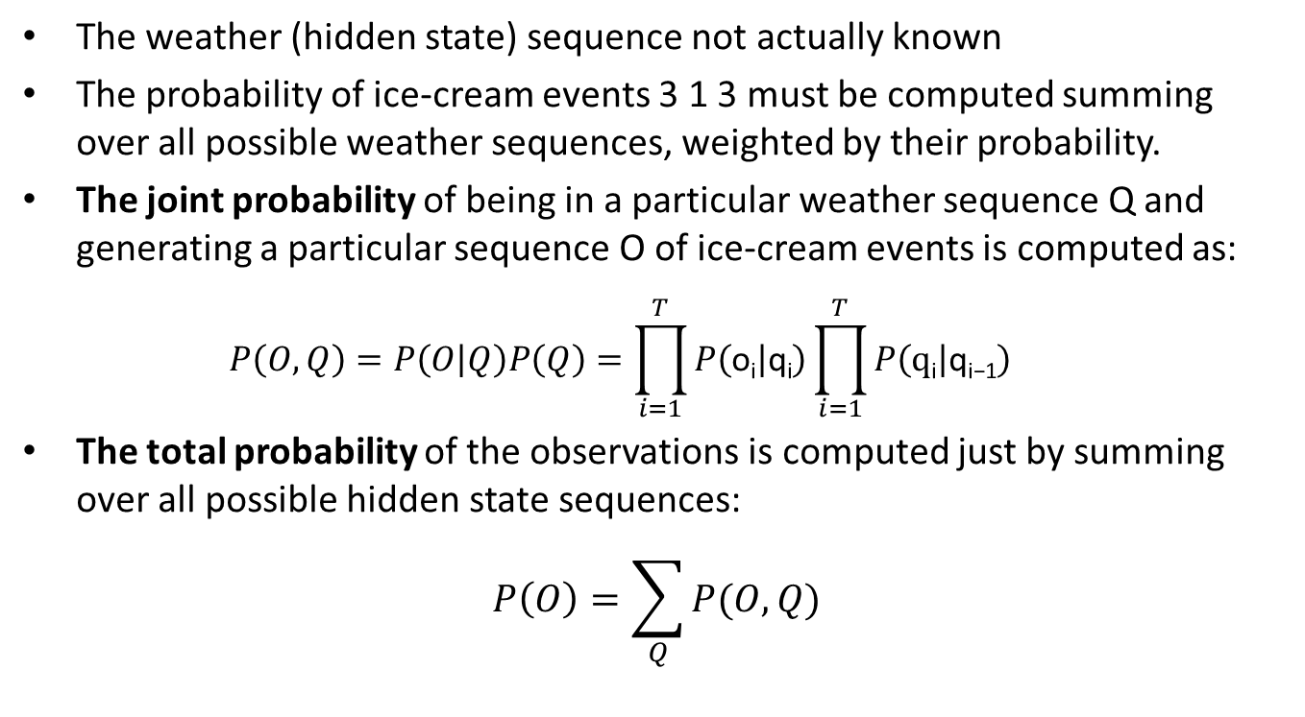
The Joint and Total Probabilites of Observations
The weather (hidden state) sequence not actually known
The probability of ice-cream events 3 1 3 must be computed summing over all possible weather sequences, weighted by their probability.
The joint probability of being in a particular weather sequence Q and generating a particular sequence O of ice-cream events is computed as:
$$P\left(O,Q\right)=P\left(O | Q\right)P\left(Q\right)=\prod_{i=1}^{T}{P\left(\text{o}\text{i} | \text{q}\text{i}\right)}\prod_{i=1}^{T}{P\left(\text{q}\text{i} | \text{q}\text{i}\text{−1}\right)}$$
The total probability of the observations is computed just by summing over all possible hidden state sequences:
$$P\left(O\right)=\sum_{Q}{P(O,Q)}$$

Slide 29

Ice-Cream Example
The joint probability of
P(3 1 3,hot hot cold) =
P(hot|start) x P(hot|hot) x P(cold|hot )x
P(3|hot) x P(1|hot) x P(3|cold)
The total probability
P(3 1 3) = P(3 1 3,cold cold cold) +
P(3 1 3,cold cold hot)+P(3 1 3,hot hot cold)+…
For this particular case, the eight 3-event sequences of cold cold cold, cold cold hot, … are summed
.8

Slide 30
Likelihood Computation: The Forward Algorithm
For an HMM with N hidden states and an observation sequence of T observations
there are N^{T} possible hidden sequences
For real tasks, where N and T are both large
Hard to compute the total observation probabilities by computing joint probabilities and then summing them
The forward algorithm
is O(N²T)
a dynamic programming algorithm,
an algorithm that uses a table to store intermediate values as it builds up the probability of the observation sequence.
efficiently computes the observation likelihood by implicitly folding each of the possible hidden state paths into a single forward trellis

Slide 31
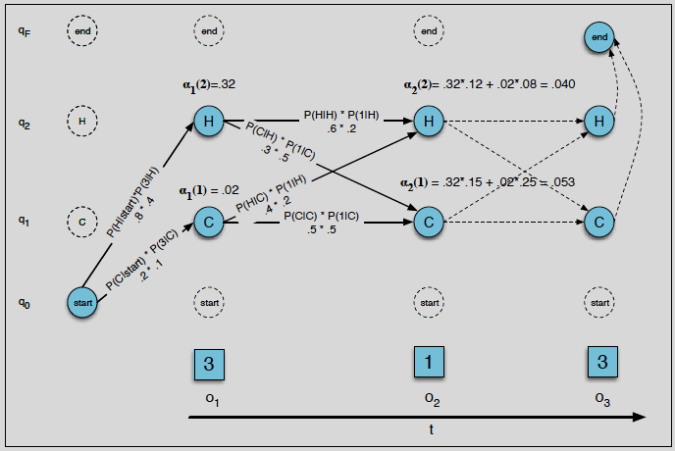
The Forward Algorithm: Trellis
The forward trellis for computing the total observation likelihood for the ice-cream events 3 1 3.
Hidden states are in circles, observations in squares.
White (unfilled) circles indicate illegal transitions.

Slide 32
The Forward Algorithm: Trellis

Slide 33
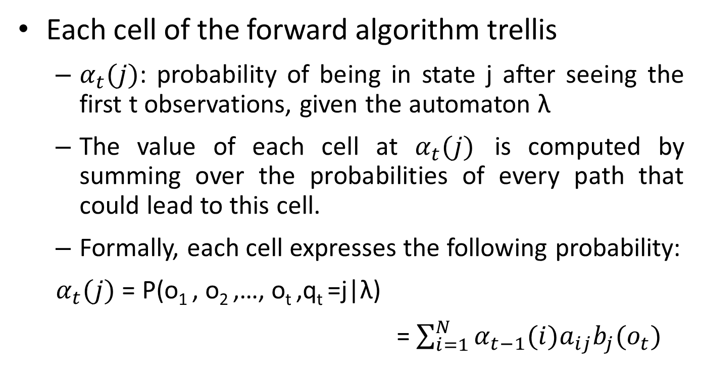
The Forward Algorithm: Trellis
Each cell of the forward algorithm trellis
$α_{t}(j)$: probability of being in state j after seeing the first t observations, given the automaton λ
The value of each cell at $α_{t}(j)$ is computed by summing over the probabilities of every path that could lead to this cell.
Formally, each cell expresses the following probability:
$α_{t}(j)$ = P(o₁ , o₂ ,…, o_{t} ,q_{t} =j|λ)
=$\sum_{i=1}^{N}{α_{t−1}(i)a_{ij}b_{j}(o_{t})}$

Slide 34
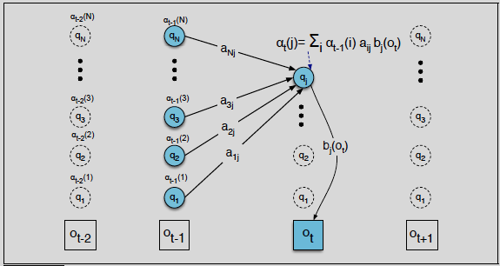
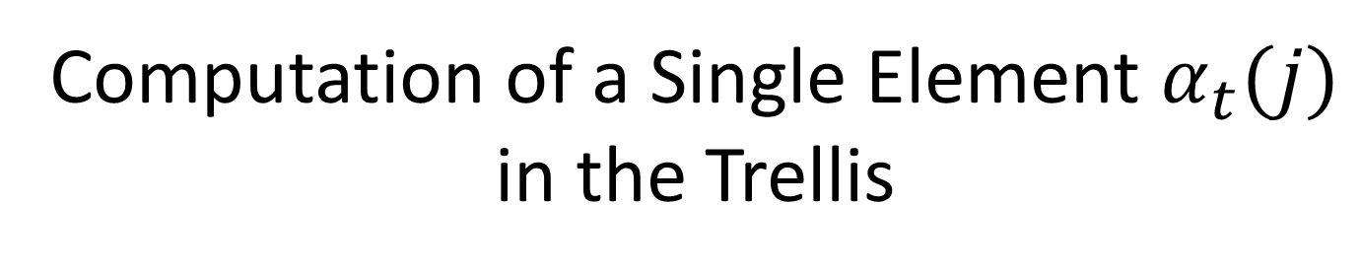
Computation of a Single Element $α_{t}(j)$ in the Trellis

Slide 35
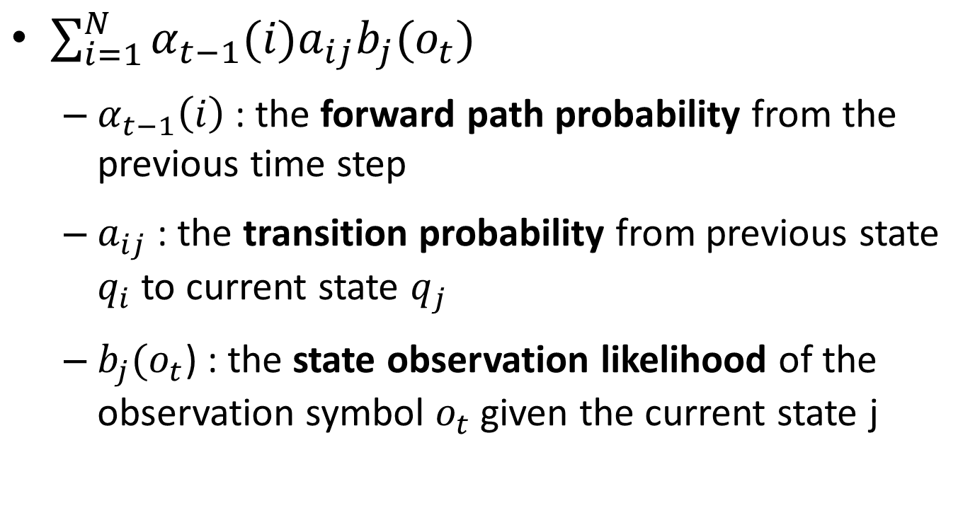
Recursive Forward Algorithm Formula: Probabilities
$\sum_{i=1}^{N}{α_{t−1}(i)a_{ij}b_{j}(o_{t})}$
$α_{t−1}\left(i\right)$: the forward path probability from the previous time step
$a_{ij}$ : the transition probability from previous state $q_{i}$ to current state $q_{j}$
$b_{j}(o_{t}$) : the state observation likelihood of the observation symbol $o_{t}$ given the current state j

Slide 36
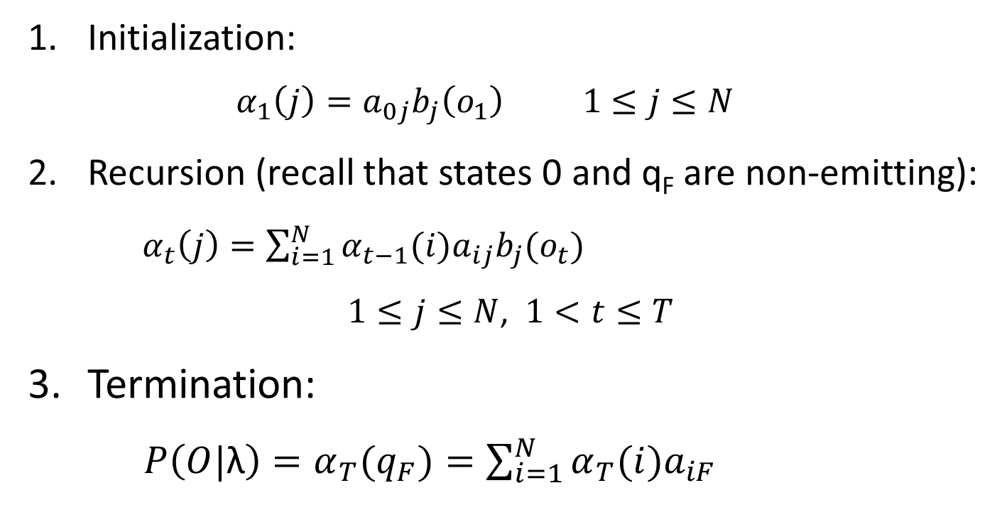
The Forward Algorithm
Initialization:
$$α_{1}\left(j\right)=a_{0j}b_{j}\left(o_{1}\right) 1≤j≤N$$
Recursion (recall that states 0 and q_{F} are non-emitting):
${ α}_{t}\left(j\right)=\sum_{i=1}^{N}{α_{t−1}(i)a_{ij}b_{j}(o_{t})}$
$1≤j≤N$, $1<t≤T$
Termination:
$P\left(O|\text{λ}\right)=α_{T}(q_{F})=\sum_{i=1}^{N}{α_{T}(i)a_{iF}}$

Slide 37
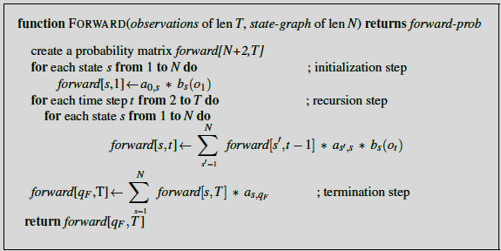
The Forward Algorithm
$forward[s,t]$ represents $α_{t}(s)$

Slide 38
Decoding:
Decoding task
which sequence of variables is the underlying source of some sequence of observations
Formally
Given as input an HMM λ = (A,B) and a sequence of observations O = o₁,o₂,…,o_{T}
find the most probable sequence of states Q = q₁q₂q₃ … q_{T}
In the ice-cream task,
given a sequence of ice-cream observations 3 1 3 and an HMM, the task of the decoder is to find the best hidden weather sequence e.g., (H H H)

Slide 39
Decoding: The Viterbi Algorithm
It is again troublesome to compute the likelihood of the observation sequence for each possible hidden state sequence (HHH, HHC, HCH, etc.)
Remember that there are an exponentially large number of state sequences
Viterbi algorithm
Like the forward algorithm, is a kind of dynamic programming algorithm
makes uses of a dynamic programming trellis

Slide 40
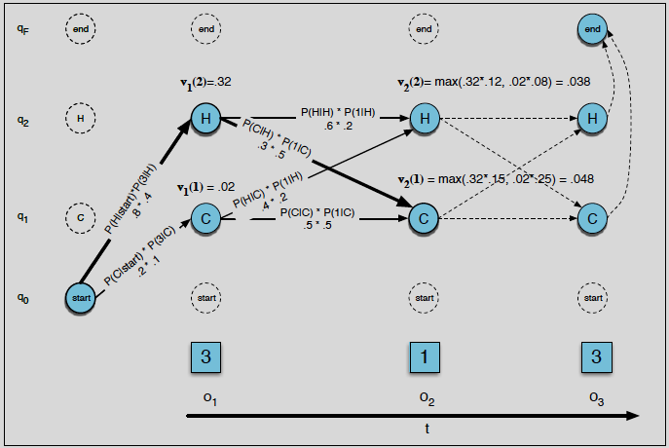
The Viterbi Algorithm: Trellis

Slide 41
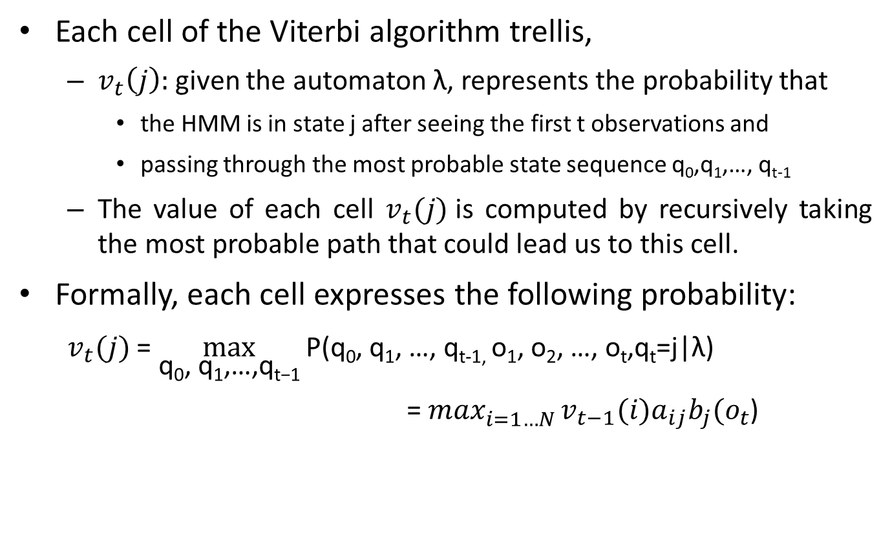
The Viterbi Algorithm: Trellis
Each cell of the Viterbi algorithm trellis,
$v_{t}\left(j\right):$given the automaton λ, represents the probability that
the HMM is in state j after seeing the first t observations and
passing through the most probable state sequence q₀,q₁,…, q_{t-1}
The value of each cell $v_{t}(j)$is computed by recursively taking the most probable path that could lead us to this cell.
Formally, each cell expresses the following probability:
$v_{t}(j)$ = $\max_{\text{q}\text{0}\text{, }\text{q}\text{1}\text{,}\text{…}\text{,}\text{q}\text{t}\text{−}\text{1}}{\text{P}\text{(}\text{q}\text{0}\text{, }\text{q}\text{1}\text{,} \text{…}\text{, }\text{q}\text{t}\text{−}\text{1}\text{, }\text{o}\text{1}\text{, }\text{o}\text{2}\text{,} \text{…}\text{, }\text{o}\text{t}\text{,}\text{q}\text{t}\text{=}\text{j}\text{|}\text{λ}\text{)} }$
=$\max_{i=1…N }^{ }v_{t−1}(i)a_{ij}b_{j}(o_{t}$)

Slide 42
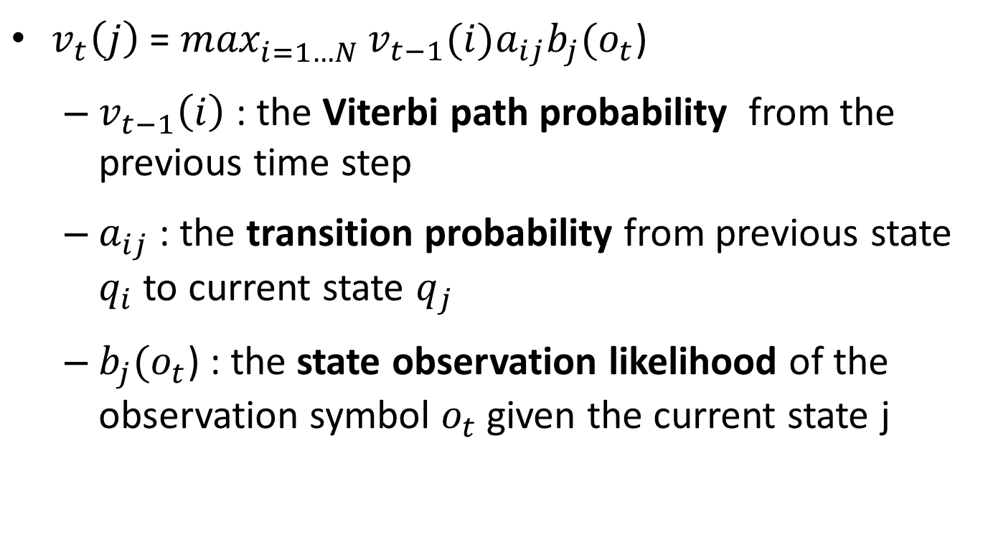
Recursive Viterbi Algorithm Formula: Probabilities
${v_{t}\left(j\right)\text{ =} max}_{i=1…N }^{ }v_{t−1}(i)a_{ij}b_{j}(o_{t}$)
$v_{t−1}\left(i\right)$: the Viterbi path probability from the previous time step
$a_{ij}$ : the transition probability from previous state $q_{i}$ to current state $q_{j}$
$b_{j}(o_{t}$) : the state observation likelihood of the observation symbol $o_{t}$ given the current state j

Slide 43
Viterbi Algorithm versus Forward Algorithm
Viterbi algorithm is identical to the forward algorithm except that
Viterbi algorithm takes the max over the previous path probabilities
Forward algorithm takes the sum over the previous path probabilities
Viterbi algorithm additionally have backpointers
since it must produce a probability and also the most likely state sequence
the best state sequence was computed by keeping track of the path of hidden states that led to each state
at the end the best path to the beginning was backtraced

Slide 44
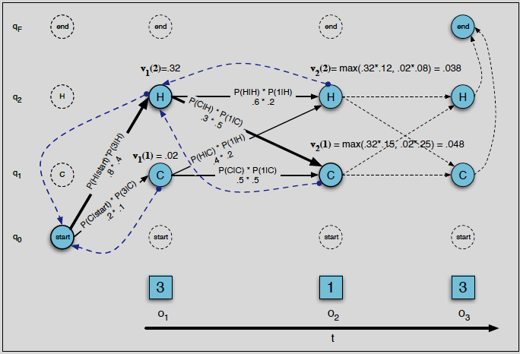
The Viterbi Algorithm: Backtrace
Notes:
As we extend each path to a new state account for the next observation,
we keep a backpointer (shown with broken lines) to the best path that led us to this state.

Slide 45
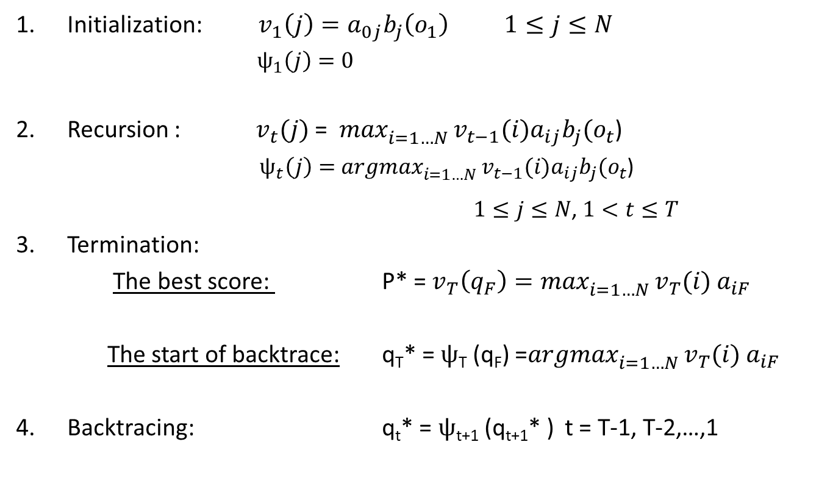
The Viterbi Algorithm
Initialization: $v_{1}\left(j\right)=a_{0j}b_{j}\left(o_{1}\right) 1≤j≤N$
$ψ_{1}\left(j\right)=0$
Recursion : $v_{t}(j)$ =$\max_{i=1…N }^{ }v_{t−1}(i)a_{ij}b_{j}(o_{t}$)
$ψ_{t}\left(j\right)=$ ${argmax}_{i=1…N }^{ }v_{t−1}(i)a_{ij}b_{j}(o_{t}$)
$1≤j≤N$, $1<t≤T$
Termination:
The best score: P* = $v_{T}\left(q_{F}\right)=\max_{i=1…N }^{ }v_{T}(i){ a}_{iF}$
The start of backtrace: q_{T}* = $ψ$_{T} (q_{F}) =${argmax}_{i=1…N }^{ }v_{T}(i){ a}_{iF}$
Backtracing: q_{t}* = $ψ$_{t+1} (q_{t+1}* ) t = T-1, T-2,…,1

Slide 46
The Viterbi Algorithm Summary
Viterbi algorithm for finding optimal sequence of hidden states.
Given an observation sequence and an HMM
Returns the state path through the HMM that assigns maximum likelihood to the observation sequence

Slide 47
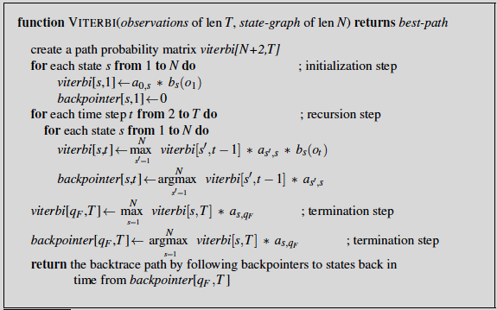
Decoding: The Viterbi Algorithm

Slide 48
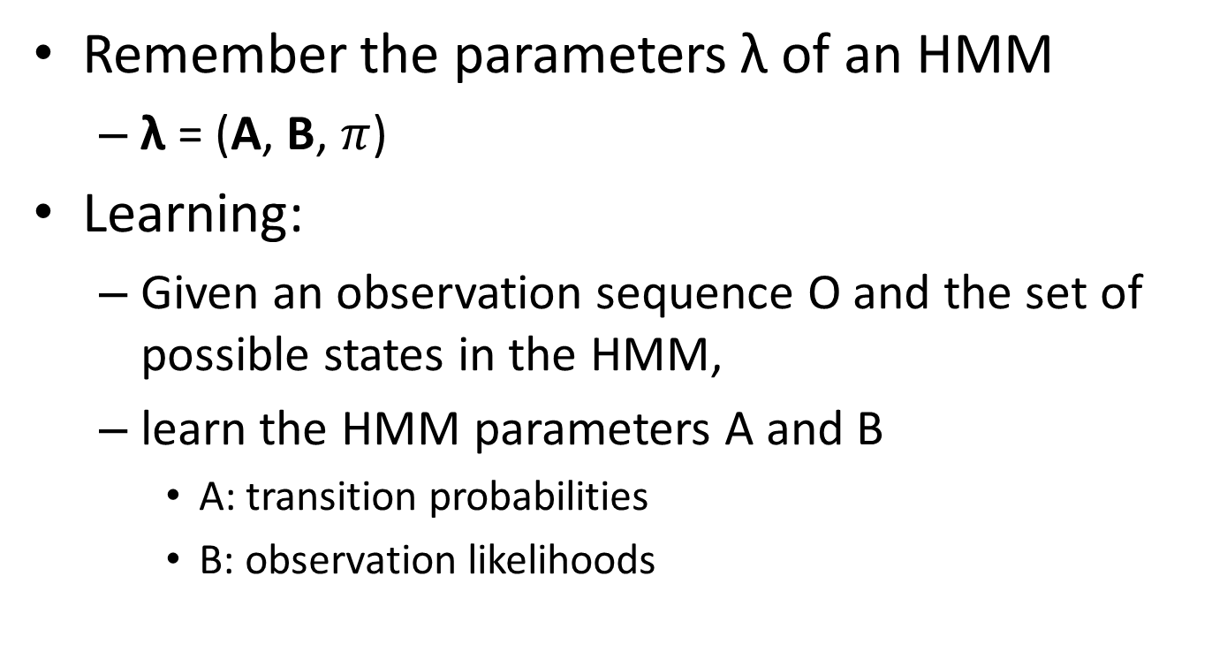
HMM Learning
Remember the parameters λ of an HMM
λ = (A, B, $π$)
Learning:
Given an observation sequence O and the set of possible states in the HMM,
learn the HMM parameters A and B
A: transition probabilities
B: observation likelihoods

Slide 49
HMM Learning
The input to such a learning algorithm
an unlabeled sequence of observations O
a vocabulary of potential hidden states Q
for the ice cream task,
a sequence of observations O = (1,3,2,…)
the set of hidden states H and C
for the part-of-speech tagging task,
a sequence of word observations O = (w1,w2,w3, …)
a set of hidden states corresponding to parts of speech Noun, Verb, Adjective, etc.

Slide 50
Learning: Forward-Backward Algorithm
The standard algorithm for HMM training is,
the forward-backward, or BaumWelch algorithm
a special case of the Expectation-Maximization (EM) algorithm
EM is an iterative algorithm
works by computing an initial estimate for the probabilities,
then computes a better estimate using previous estimates,
iteratively improves the probabilities that it learns.

Slide 51
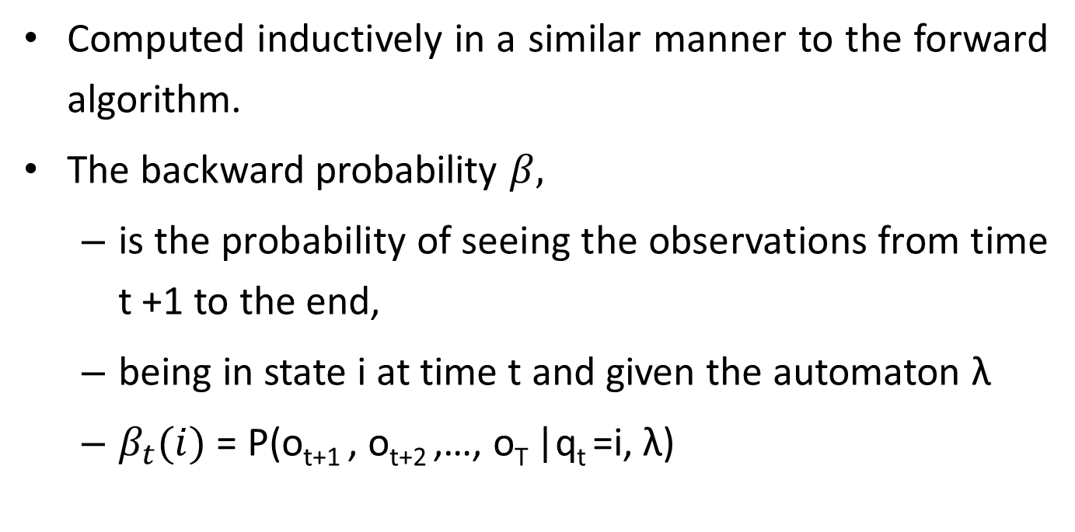
Computing Backward Probabilities
Computed inductively in a similar manner to the forward algorithm.
The backward probability $β,$
is the probability of seeing the observations from time t +1 to the end,
being in state i at time t and given the automaton λ
$β_{t}(i)$ = P(o_{t+1} , o_{t+2} ,…, o_{T} |q_{t} =i, λ)

Slide 52
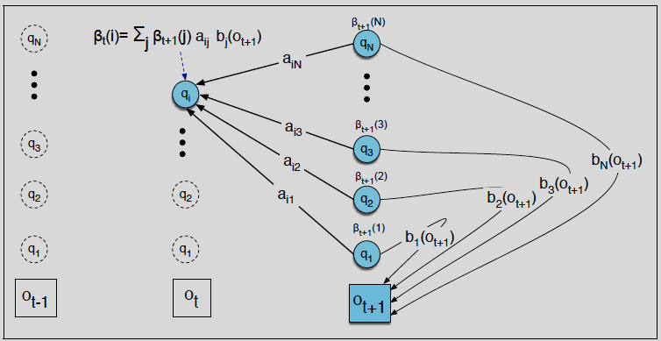
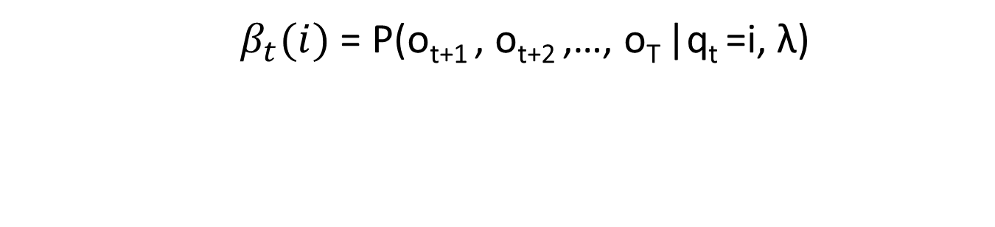
Computing Backward Probabilities
$β_{t}(i)$ = P(o_{t+1} , o_{t+2} ,…, o_{T} |q_{t} =i, λ)

Slide 53
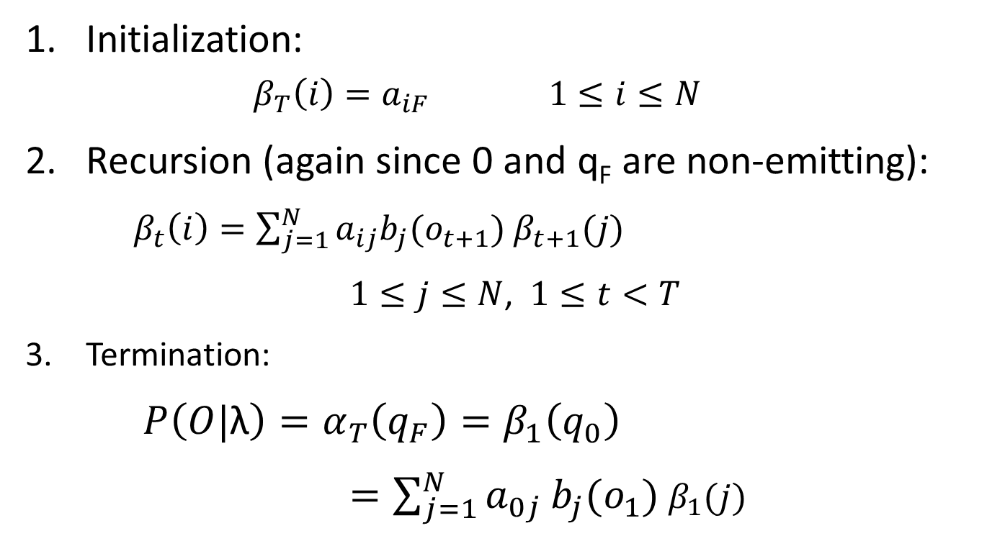
The Backward Algorithm
Initialization:
$$β_{T}\left(i\right)=a_{iF} 1≤i≤N$$
Recursion (again since 0 and q_{F} are non-emitting):
$β_{t}\left(i\right)=\sum_{j=1}^{N}{a_{ij}b_{j}(o_{t+1})}$ $β_{t+1}(j)$
$1≤j≤N$, $1≤t<T$
Termination:
$P\left(O|\text{λ}\right)=α_{T}\left(q_{F}\right)=β_{1}\left(q_{0}\right)$
$=\sum_{j=1}^{N}{a_{0j}}b_{j}(o_{1})$ $β_{1}(j)$

Slide 54
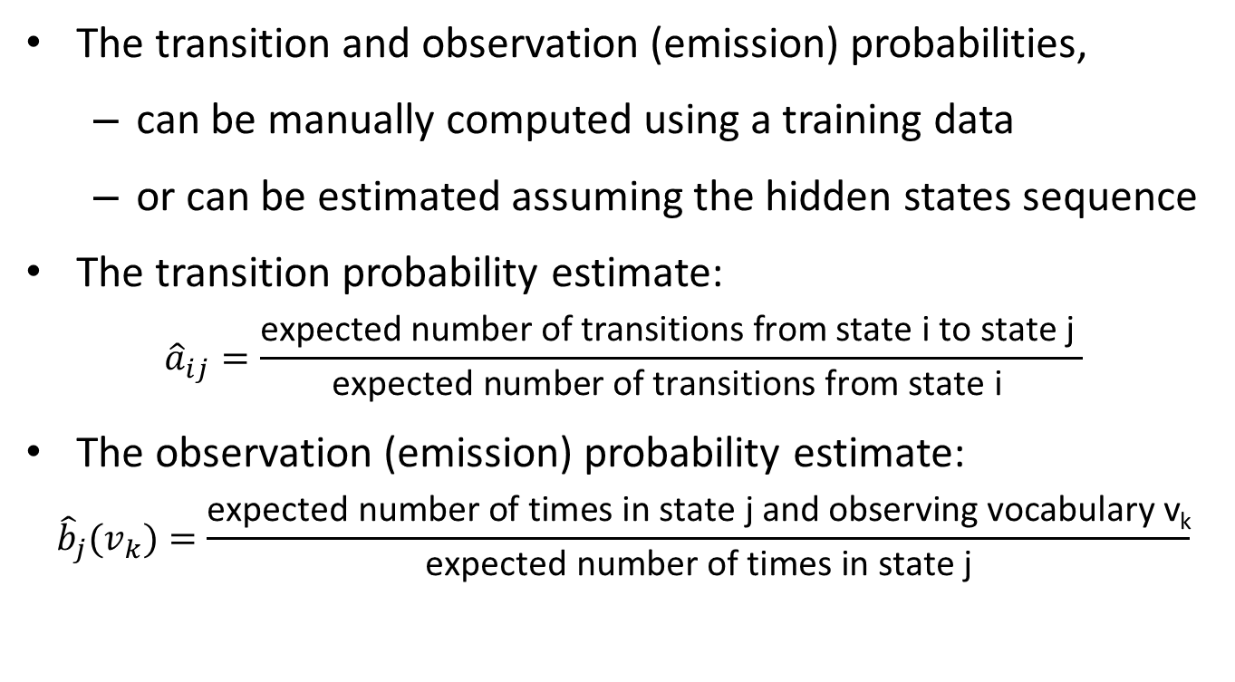
Estimating Transition and Observation Probabilities
The transition and observation (emission) probabilities,
can be manually computed using a training data
or can be estimated assuming the hidden states sequence
The transition probability estimate:
$${\hat{a}}_{ij}=\frac{\text{expected} \text{number} \text{of} \text{transitions} \text{from} \text{state} \text{i} \text{to} \text{state} \text{j} }{\text{expected} \text{number} \text{of} \text{transitions} \text{from} \text{state} \text{i} }$$
The observation (emission) probability estimate:
$${\hat{b}}_{j}(v_{k})=\frac{\text{expected} \text{number} \text{of} \text{times} \text{in} \text{state} \text{j} \text{and} \text{observing} \text{vocabulary} \text{v}\text{k}}{\text{expected} \text{number} \text{of} \text{times} \text{in} \text{state} \text{j}}$$

Slide 55
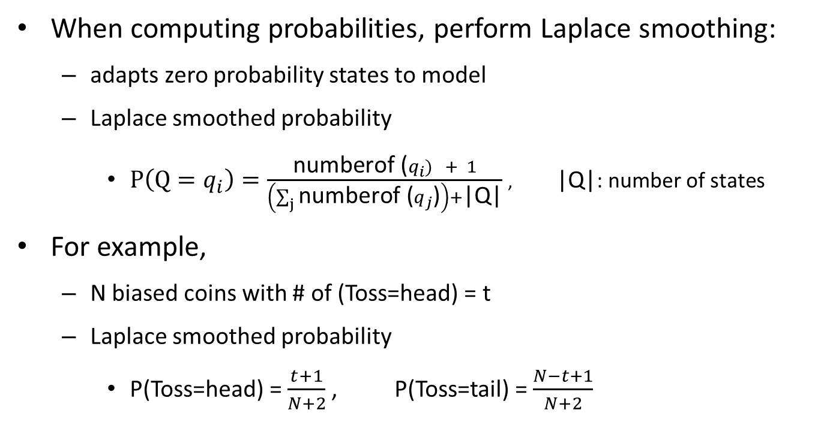
Hints on Estimating Probabilities: Laplace Smoothing
When computing probabilities, perform Laplace smoothing:
adapts zero probability states to model
Laplace smoothed probability
$P\left(Q=q_{i}\right)=\frac{\text{numberof} \text{(}q_{i}) + 1}{\left(\sum_{j}{\text{numberof} \text{(}q_{j}\text{)}}\right)+\text{|}\text{Q}\text{|}}$,$\text{|}\text{Q}\text{|}$: number of states
For example,
N biased coins with # of (Toss=head) = t
Laplace smoothed probability
P(Toss=head) = $\frac{t+1}{N+2}$, P(Toss=tail) = $\frac{N−t+1}{N+2}$

Slide 56
Hints on Estimating Probabilities: Logarithmic Transformation
Iterative multiplication of many probabilities results in smaller numbers, which gradually approach to zero
Instead of directly working with the probabilities, work with their logarithm
For example,
recompute probabilities of p and q as log(p) and log(q)
to estimate p.q product in logarithmic space, apply the following rule,
log(pq) = log(p) + log(q)

Slide 57
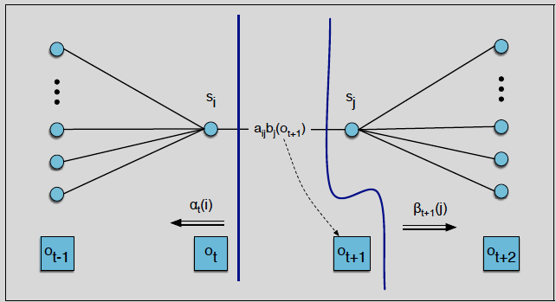
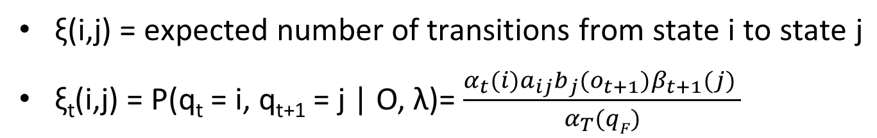
ξ Computation
$\text{ξ}\text{(}\text{i}\text{,}\text{j}\text{) = }\text{expected} \text{number} \text{of} \text{transitions} \text{from} \text{state} \text{i} \text{to} \text{state} \text{j}$
$\text{ξ}\text{t}$(i,j) = P(q_{t} = i, q_{t+1} = j | O, λ)= $\frac{α_{t}(i)a_{ij}b_{j}(o_{t+1})β_{t+1}(j) }{α_{T}(qF)}$
Notes:
ξ :Xi

Slide 58
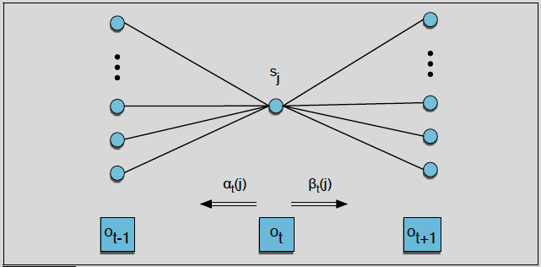
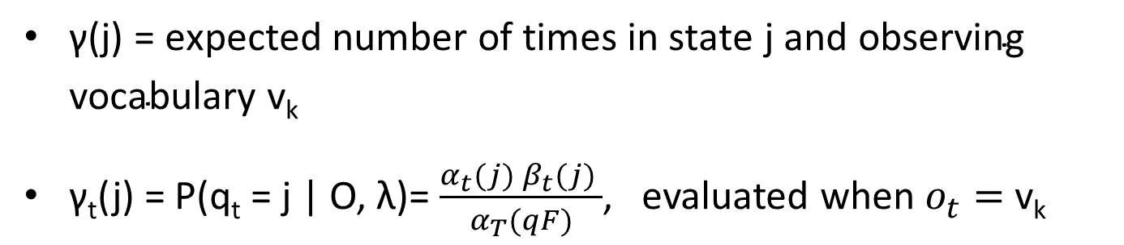
γ Computation
$\text{γ}\text{(}\text{j}\text{) =} \text{expected} \text{number} \text{of} \text{times} \text{in} \text{state} \text{j} \text{and} \text{observing} \text{vocabulary} \text{v}\text{k}$
$\text{γ}\text{t}$(j) = P(q_{t} = j | O, λ)= $\frac{α_{t}(j) β_{t}(j) }{α_{T}(qF)}$, evaluated when $o_{t}=$ $\text{v}\text{k}$

Slide 59
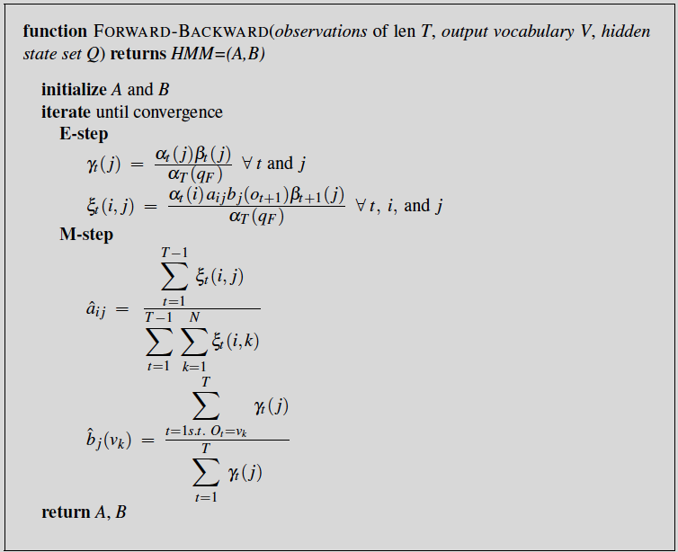
Learning: Forward-Backward Algorithm
Notes:
The Baum-Welch algorithm uses two intuitions,
We will start with an estimate for the transition and observation probabilities and then use these estimated probabilities to derive better and better probabilities.
The second idea is that we get our estimated probabilities by computing the forward probability for an observation and then dividing that probability mass among all the different paths that contributed to this forward probability.

Slide 60
Learning: Forward-Backward Algorithm
In principle the forward-backward algorithm can do completely unsupervised learning of the A and B parameters
In practice the initial conditions are very important
algorithm is often given extra information
For speech recognition,
the HMM structure is often set by hand
only the emission (B) and (non-zero) A transition probabilities are trained from a set of observation sequences O
Notes:
Section ?? in Chapter 31 also discusses how initial A and B estimates are derived in speech recognition. We also show that for speech the forward-backward algorithm can be extended to inputs that are non-discrete (“continuous observation densities”).

Slide 61
Speech Recognition
Since the mid-1970s, speech recognition has been formulated as probabilistic inference
«Context» effects (coarticulation etc.) are handled by augmenting state
Variability in human speech (speed, timbre, etc.) and background noise make continuous speech recognition in real settings an open problem
Today better performances are achieved by deep learning models
Notes:
Coarticulation: hece birleşimlerinde ses benzeşimi
Timbre: tını

Slide 62
Speech as Probabilistic Inference
What is the most likely word sequence, given the speech signal?
i.e., choose Words to maximize P(Words|signal)
Use Bayes' rule:
P(Words|signal) = P(signal|Words)P(Words)
i.e., decomposes into acoustic model + language model
evidence (observation) = speech signal
hidden variables = word and phone sequences

Slide 63
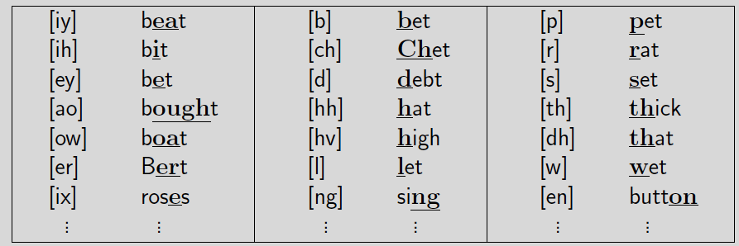
Phones
All human speech is composed from 40-50 phones, determined by the configuration of articulators (lips, teeth, tongue, vocal cords, air flow)
Form an intermediate level of hidden states between words and signal
acoustic model = pronunciation model + phone model
ARPAbet designed for American English
e.g., «ceiling» is [s iy l ih ng] / [s iy l ix ng] / [s iy l en]
Notes:
Articulators: konuşurken ses çıkarmaya yarayan konuşma organı

Slide 64
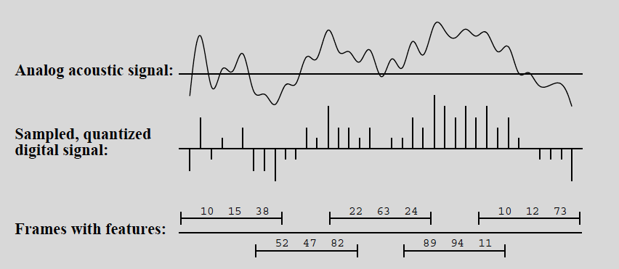
Speech Sounds
Raw signal is the microphone displacement as a function of time;
processed into overlapping 30ms frames, each described by features
Frame features are typically formants, which are peaks in the power spectrum
Notes:
Formant: biçimlendirici
A band of frequencies, in a sound spectrum, that have a greater intensity;
they determine the quality of a sound; especially the characteristic sounds of the consonants

Slide 65
Phone Models
Frame features in P(features|phone) summarized by
an integer in [0,…,255] (using vector quantization) or
the parameters of a mixture of Gaussians
Three-state phones:
each phone has three phases (Onset, Mid, End)
[t] has silent Onset, explosive Mid, hissing End
e.g., tongue, star, eighth
P(features|phone, phase)
Notes:
Triphone context: each phone becomes n² distinct phones, depending on the phones to its left and right
E.g., [t] in «star» is written [t(s,aa)] (different from \tar"!)
Triphones useful for handling coarticulation effects:
the articulators have inertia and cannot switch instantaneously between positions
e.g., [t] in «eighth» has tongue against front teeth

Slide 66
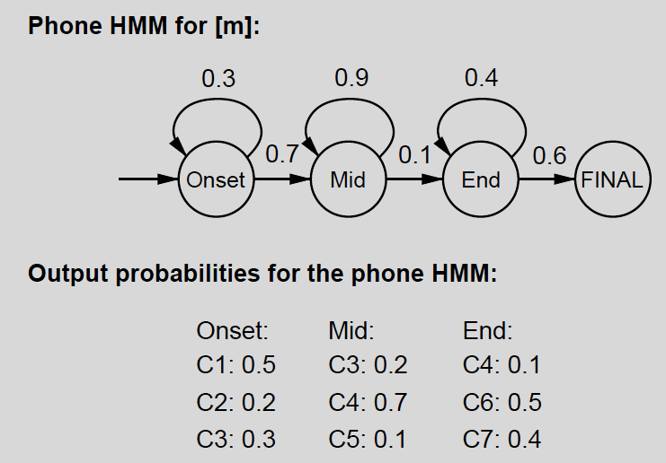
Phone Model Example
C1 through C7: associated acoustic models that are labeled by the vector quantization algorithm
Self-loops indicate state persistance, i.e. expected duration spent in a state

Slide 67
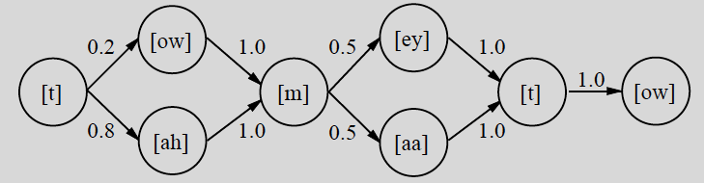
Word Pronunciation Models
Each word is described as a distribution over phone sequences
Distribution represented as an HMM transition model
Structure is generated manually to model pronounciation and coarticulation effects, transition probabilities learned from data
P([towmeytow]|"tomato") = P([towmaatow]|"tomato") = 0.1
P([tahmeytow]|"tomato") = P([tahmaatow]|"tomato") = 0.4

Slide 68
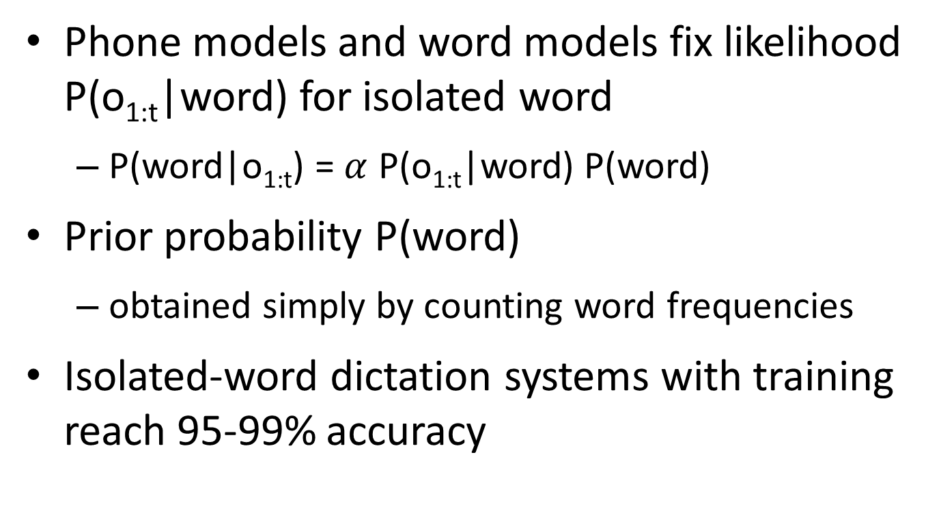
Isolated Words
Phone models and word models fix likelihood P(o_{1:t}|word) for isolated word
P(word|o_{1:t}) = $α$ P(o_{1:t}|word) P(word)
Prior probability P(word)
obtained simply by counting word frequencies
Isolated-word dictation systems with training reach 95-99% accuracy

Slide 69
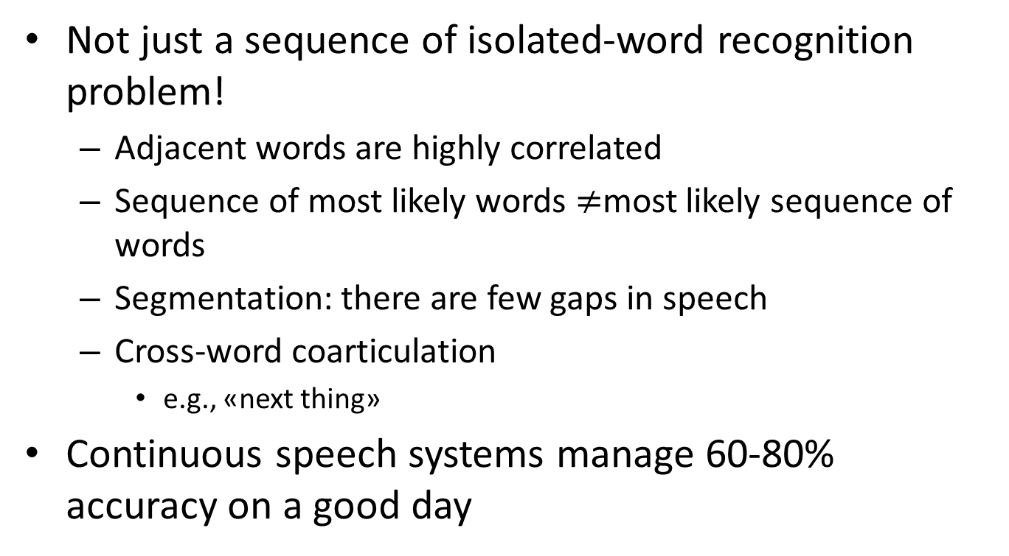
Continuous Speech
Not just a sequence of isolated-word recognition problem!
Adjacent words are highly correlated
Sequence of most likely words $≠$most likely sequence of words
Segmentation: there are few gaps in speech
Cross-word coarticulation
e.g., «next thing»
Continuous speech systems manage 60-80% accuracy on a good day

Slide 70
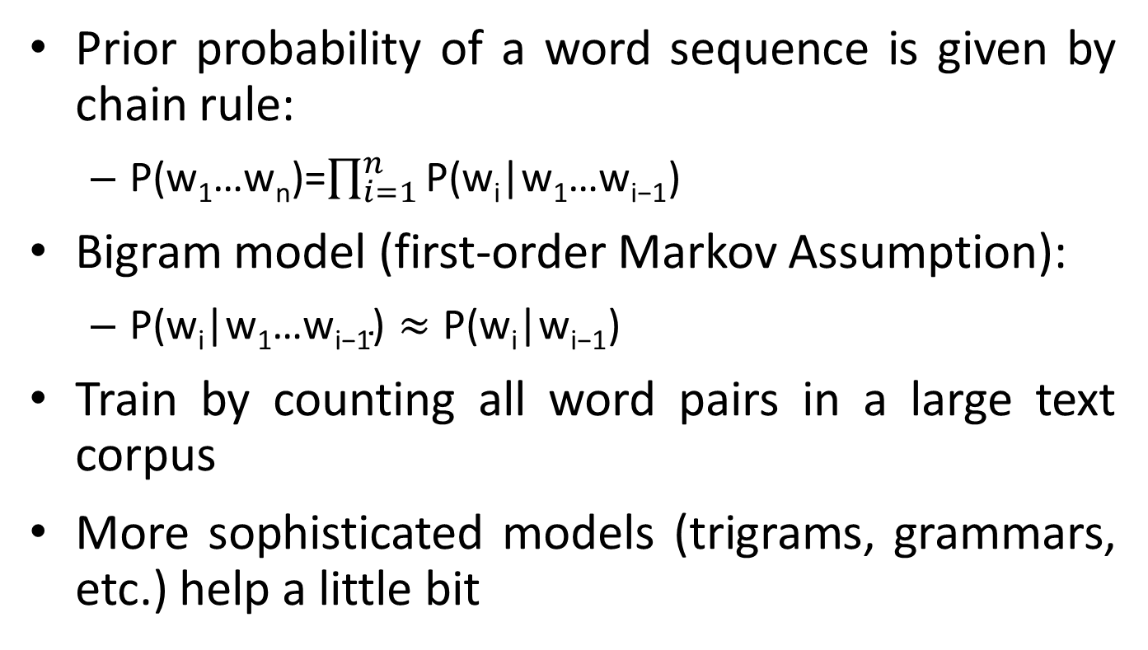
Language Model
Prior probability of a word sequence is given by chain rule:
P(w₁…w_{n})=$\prod_{i=1}^{n}{\text{P}\text{(}\text{w}\text{i}\text{|}\text{w}\text{1}\text{…}\text{w}\text{i}\text{−}\text{1}}$)
Bigram model (first-order Markov Assumption):
$\text{P}\text{(}\text{w}\text{i}\text{|}\text{w}\text{1}\text{…}\text{w}\text{i}\text{−}\text{1}\text{)}≈\text{P}\text{(}\text{w}\text{i}\text{|}\text{w}\text{i}\text{−}\text{1}$)
Train by counting all word pairs in a large text corpus
More sophisticated models (trigrams, grammars, etc.) help a little bit

Slide 71
Combined HMM
States of the combined language+word+phone model are labelled by
the word we're in
the phone in that word
the phone state in that phone
Viterbi algorithm finds the most likely phone state sequence
Does segmentation by considering all possible word sequences and boundaries
Doesn't always give the most likely word sequence because each word sequence is the sum over many state sequences

Slide 72
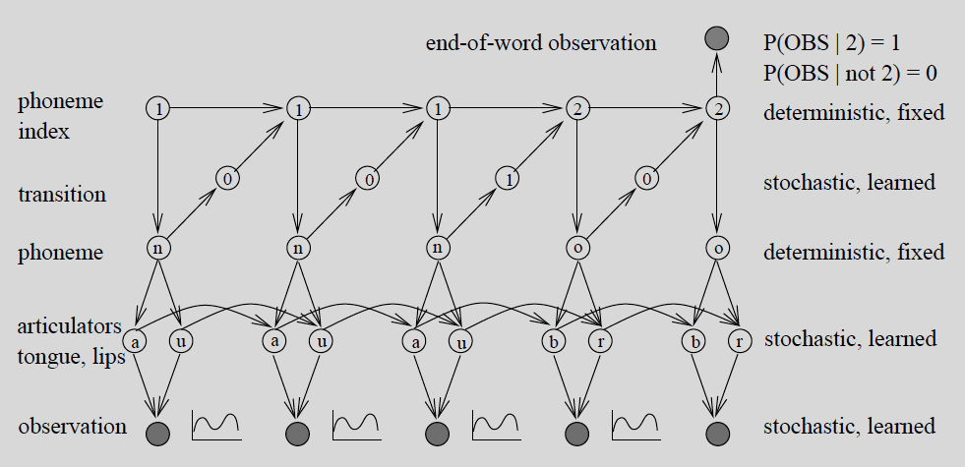
DBNs for Speech Recognition
Also easy to add variables for, e.g., gender, accent, speed.
Error reduction over HMMs is high
Notes:
Zweig and Russell (1998) show up to 40% error reduction over HMMs

Slide 73
Additional Resources
Speech and Language Processing, Daniel Jurafsky & James H. Martin, 2016.

Slide 74
Homework III
Paylaşılan letter_recognition.data veri kümesinde toy Bayés (naïve Bayés) yöntemiyle A’dan Z’ye 26 farklı harfin sınıflandırılmasını gerçekleştiriniz. Veride,
Farklı font ve rasgele tahrifat ile çeşitlendirilen 26 harf için harfi sınırlandıran kutular üzerinden kutunun yatay ve düşey koordinatı, kutunun eni ve boyu, görüntü içerisindeki harfi ifade eden piksellerin sayısı benzeri 16 adet özellik çıkartılmıştır.
İlk satırda sütun açıklamaları, takip eden 20000 satırda ise örneklerle (samples) düzenlenmiştir.
Her bir örnek harfin türü ve [0-15] değerleri arasında sayısallaştırılan 16 adet özelliği barındırır.
Verideki örnekler içerisinden ilk 16000 tanesi ile toy Bayés modeli oluşturulacak son 4000 tanesi ile de model sınanacaktır.
Dosya içerisindeki örnekleri okuyan ve gruplandıran LR.py uygulaması referans olarak paylaşılmıştır.
Olasılık modelini oluşturabilmek için bu slaytın notlar kısmında verilen adımlar takip edilmelidir.
Notes:
Eğitim örnekleri içerisindeki harf örnekleri gruplandırılarak öncül (koşulsuz) olasılıklar P(Letter) hesaplanır öyle ki Letter $= \{A, B, C, … , Z\}$.
Eğitim örnekleri içerisindeki harf örnekleri ve 16 özelliğin her biri birlikte gruplandırılarak soncul (koşullu) olasılıklar P($F_{1}$|Letter), P($F_{2}$| Letter), … , P($F_{N}$| Letter) hesaplanır öyle ki $F_{1}…F_{N}=\{0, 1,…,15\}$. Özellikler ayrık değişkenler olarak ele alınabileceği gibi sürekli değişkenler olarak da ele alınabilir.
Özellikler ayrık değişkenler olarak ele alınırsa olasılık dağılımını ifade eden bir dizi elde edilir. Eğer ki bir harf için ilgili özelliğin ayrık bir değeri hiç oluşmamışsa olasılığı sıfır olur. Bu durum tahmin zamanında problemlere sebep olur. Laplace düzgünleştirmesi sıfır olasılıklı değerleri de modele adapte eder. Bunun için olasılıklar aşağıdaki formüle göre hesaplanır.
$$P\left(F_{i}=v_{j}|Letter\right)=\frac{v_{j}^{′}nin Letter^{′}da oluşma sayısı+1}{\left(\sum_{k}{v_{k}^{′}nın Letter^{′}da oluşma sayısı}\right)+|Ayrık değer|}$$
Örneğin A harfi görüldüğünde $F_{1}$ = 15 olma olasılığı,
$P\left(F_{i}=v_{j}|Letter\right)=\frac{0+1}{633+16}=0.00154$ olur.
Özellikler sürekli değişkenler olarak ele alınırsa ilgili özelliğin ortalama ($μ$) ve standart sapma ($σ$) değerlerinin hesaplanması gerekir. Bu sayede herhangi bir özellik değerinin olasılığı normal dağılıma bağlı olarak şu formüle göre belirlenebilir.
$$P\left(F_{i}=v_{j}|Letter\right)=\frac{1}{\sqrt{2π}σ}e^{{−{(v_{j}−μ)}^{2}}/{2σ^{2}}}$$
Oluşturulan olasılık modeli ile son 4000 örneğin sınıfını tahmin edebilmek için şu adımlar takip edilmelidir.
Toy Bayés’in bağımsızlık varsayımına dayalı tahmin formülünü tüm harfler için aşağıdaki formüle göre hesaplayınız.
P(Letter, F₁, F₂, …, F_{N}) = P(Letter).$\prod_{i}{P}$(F_{i}| Letter)
Verilen formülde 16 özellik değerine ait olasılığın çarpılması dolayısıyla hesaplanan çarpım giderek küçülebilir. Bazı durumlarda bilgisayarın reel sayı temsil kapasitesi zorlanarak sıfırdan ayırt edilemeyecek kadar küçük sayılar elde edilebilir. Bu da olasılıkların karşılaştırılmasını imkânsız hale getirebilir. Dolayısıyla aşağıdaki formüle göre olasılıklar üzerinde önce logaritmik bir dönüşüm uygulanıp sonra çarpım yerine toplam hesaplanarak bu önlenebilir.
P(Letter, F₁, F₂, …, F_{N}) = log(P(Letter))+$\sum_{i}{P}$(F_{i}| Letter)
Nihayetinde tüm test örnekleri için tahmin edilen harf sınıfları ile gerçek sınıfları karşılaştırıp geliştirdiğiniz sistemin yüzde başarısını değerlendiriniz.
$$Tahmin\left(ω\right)={Letter}_{i},\underset{Letter}{argmax}{P(Letter, F_{1}, F_{2}, …, F_{N})}$$
$$Başarı\left(\%\right)=\frac{\sum_{i=1…26 }{\left|ω\right| öyle ki Tahmin\left(ω\right)={Letter}_{i} ve Letter\left(ω\right)={Letter}_{i}}}{\sum_{i=1…26}{\left|ω\right| öyle ki Letter\left(ω\right)={Letter}_{i} }}$$

Slide 75
Homework III (Devam)
Geliştirmiş olduğunuz sistemde toy Bayés sınıflandırıcıyı nasıl tasarladığınızı kısaca özetleyiniz.
Histogram gösterimini kullanarak tüm harfler için öncül olasılık dağılımını çizdiriniz.
Histogram gösterimini kullanarak 5 farklı harf ve 3 farklı özellik için soncul olasılık dağılımını çizdiriniz.
Farklı harfleri aynı grafik üzerinde çizdirerek 3 ayrı grafik oluşturunuz.
Test örneklerinin hangi sınıflara atandığı bilgisini tutan karmaşa matrisini oluşturup çizdiriniz.
Sisteminizin tahmin başarısını yüzde olarak karmaşa matrisi üzerinden hesaplayınız.
Notes:
06_Uncertainty and Bayes' rule ders notunun son 2 slaytına bakınız (Ukey'de güncellenmiştir). Yardımcı dokümanlara bu ödevin ekinden erişebilirsiniz.
Ödev teslim raporunuza
kodunuzun çıktısını
kısaca yöntem, analiz ve yorumlarınızı
okunaklı bir şekilde kaynak kodunuzu
eklemeniz gerekmektedir.

